Slide 1
BTB-WordNet
From LMF to TEI with XSLT
Lexical Data Masterclass, Berlin (3-7 December 2018)

Slide 2
Plan
Data
Goal
Transformation
Result
Lexical Data Masterclass, Berlin (3-7 December 2018)

Slide 3
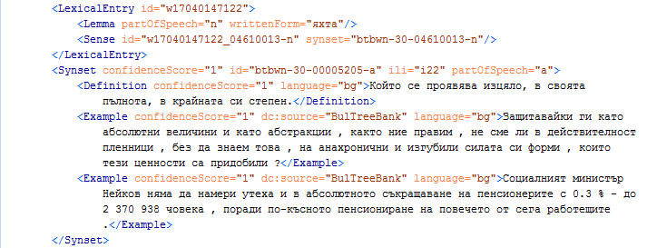
Data
Lexical Data Masterclass, Berlin (3-7 December 2018)

Slide 4
Goal
Transform the LMF file to TEI standard
Lexical Data Masterclass, Berlin (3-7 December 2018)

Slide 5
Transformation
Key to link both siblings
<tag> to <tag>
@ to @
@ to <tag>
Lexical Data Masterclass, Berlin (3-7 December 2018)

Slide 6
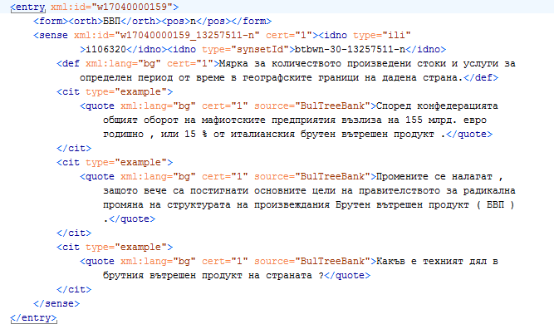
Result
Lexical Data Masterclass, Berlin (3-7 December 2018)

Slide 7
Ask, and it shall be given to you.
www.bultreebank.org
Lexical Data Masterclass, Berlin (3-7 December 2018)

Slide 8
Thank you!
Zara Kancheva
Ivaylo Radev
IICT-BAS
weirdocore93@gmail.com
radev@bultreebank.org
Lexical Data Masterclass, Berlin (3-7 December 2018)

